Slide 1
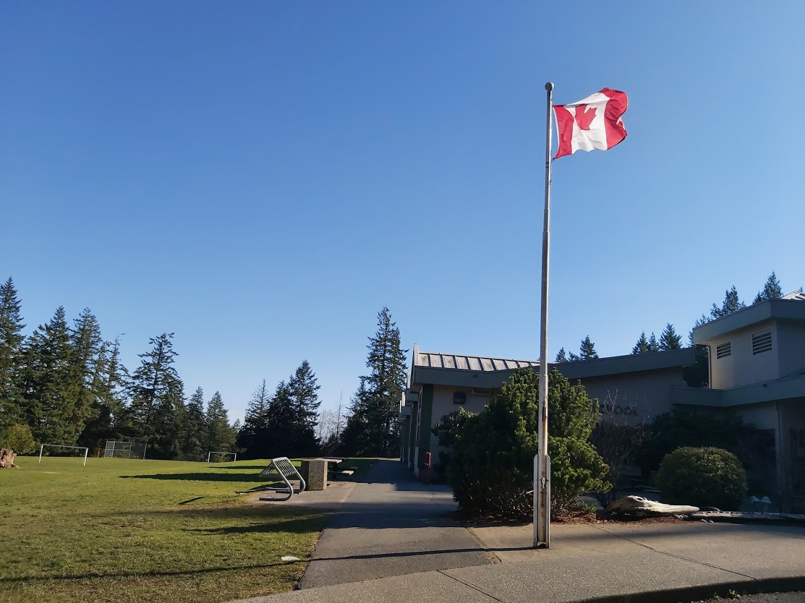
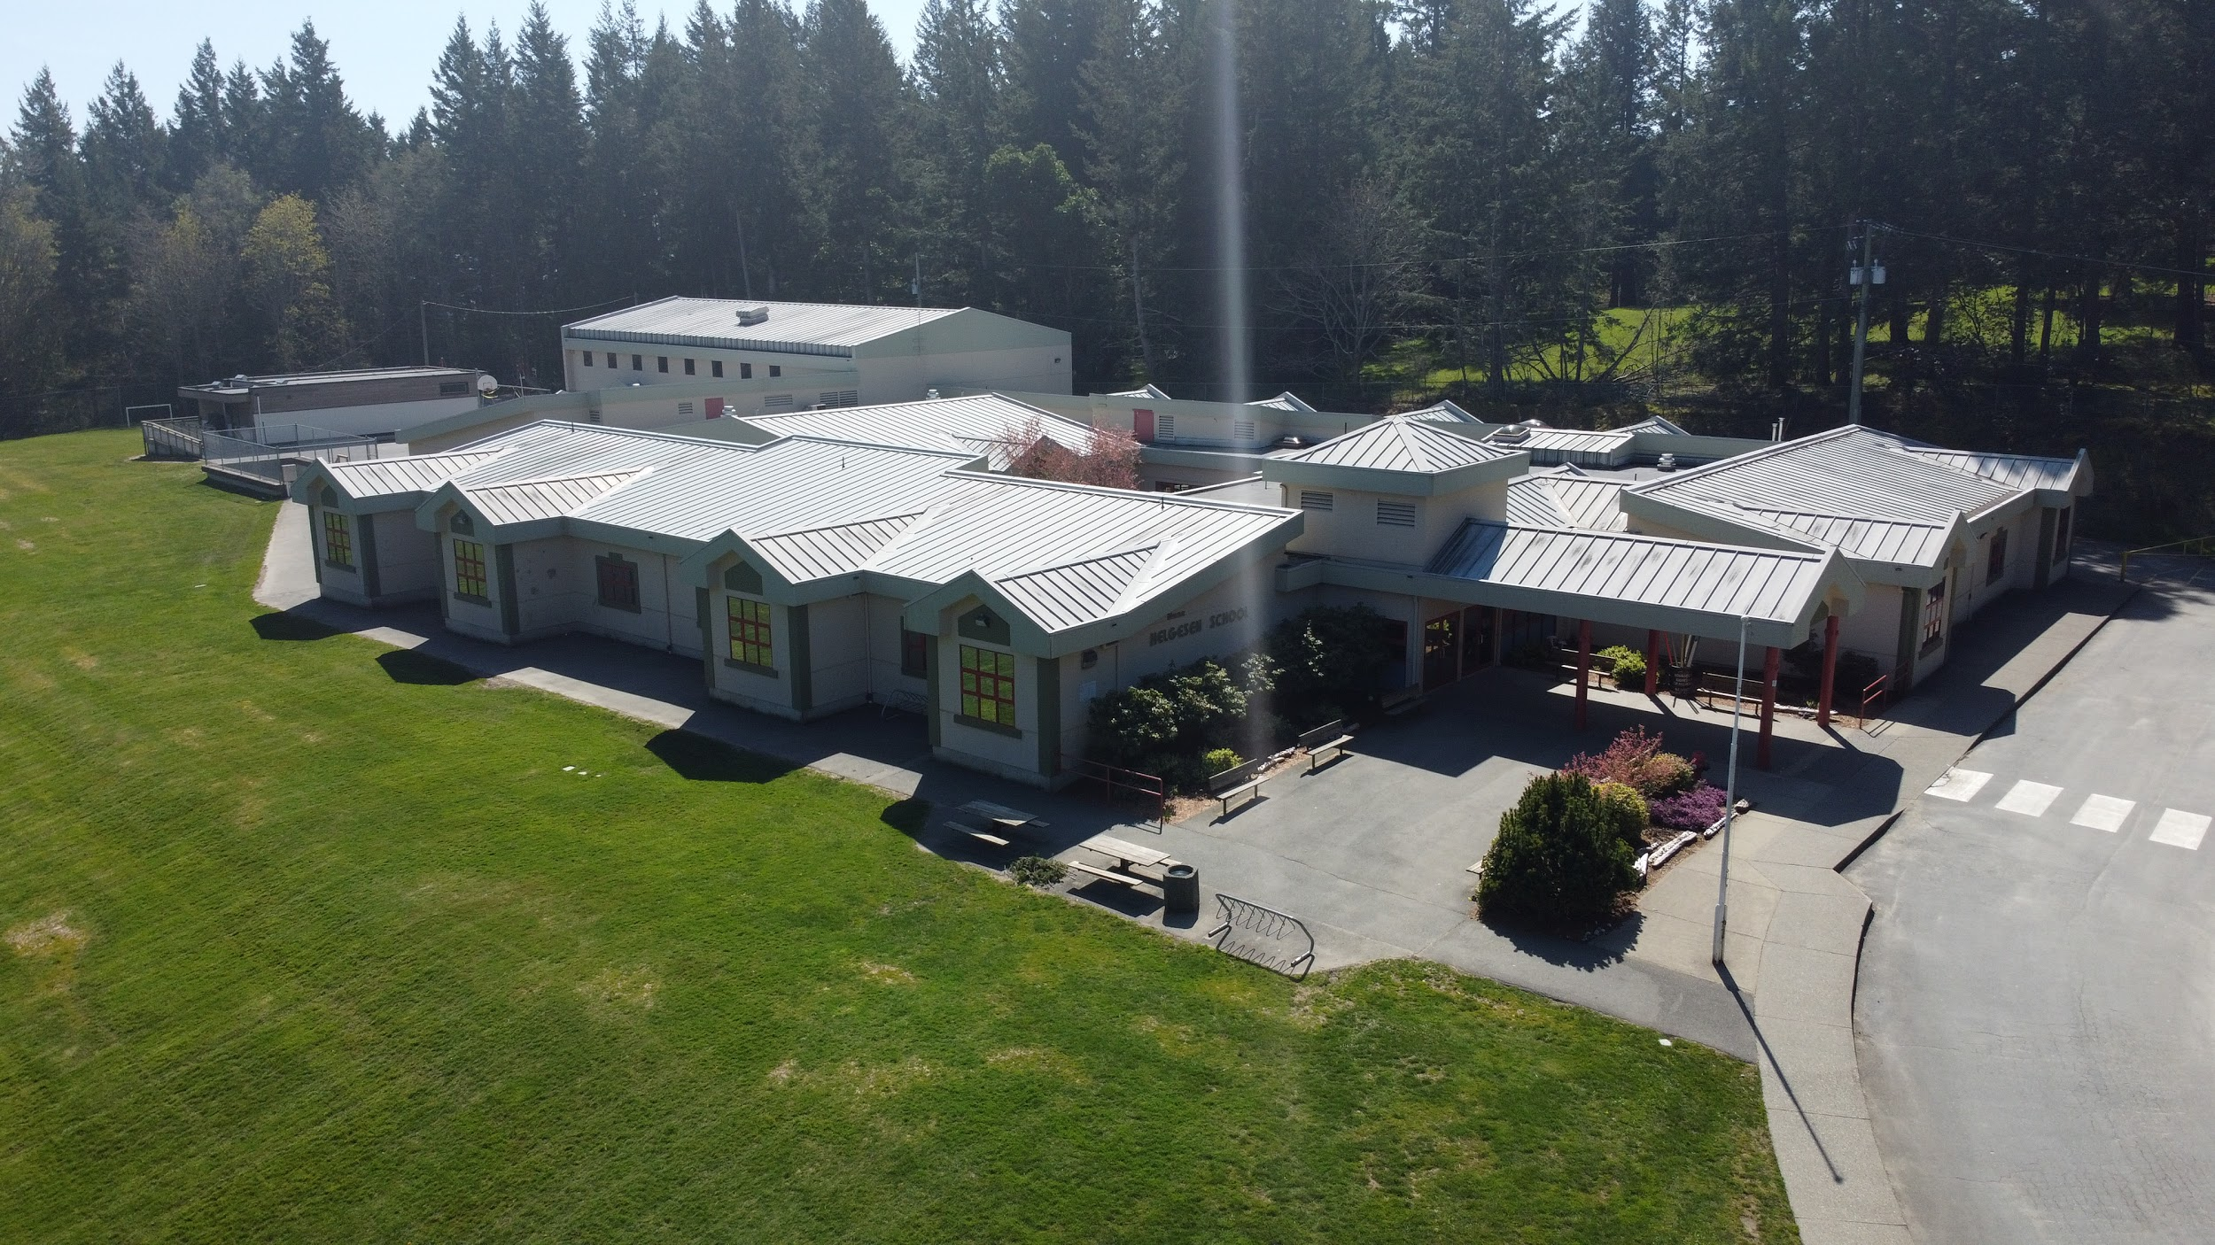
Welcome to Hans Helgesen!
O Sia’m (Honoured People)
We are the Hans Helgesen Hawks

Slide 2
Traditional Territory Acknowledgement
Territory Acknowledgments honour and show respect to the nations who have lived, worked, and played in a location since time immemorial.
We would like to acknowledge the traditional territories of the Coast Salish, specifically Sc’ianew Beecher Bay Nation on which the school is built. We thank them for sharing this beautiful land. Hych’ka – Coast Salish “Thank You”

Slide 3
Sc’ianew (Chenuh) Beecher Bay First Nation
The Sc’ianew (Cheanuh) First Nations’ main community is on Beecher Bay in East Sooke, 30 km southwest of Victoria (capital city of British Columbia). They can trace their ancestry to people who spoke four different languages. The English translation of the name means “salmon people”.

Slide 4
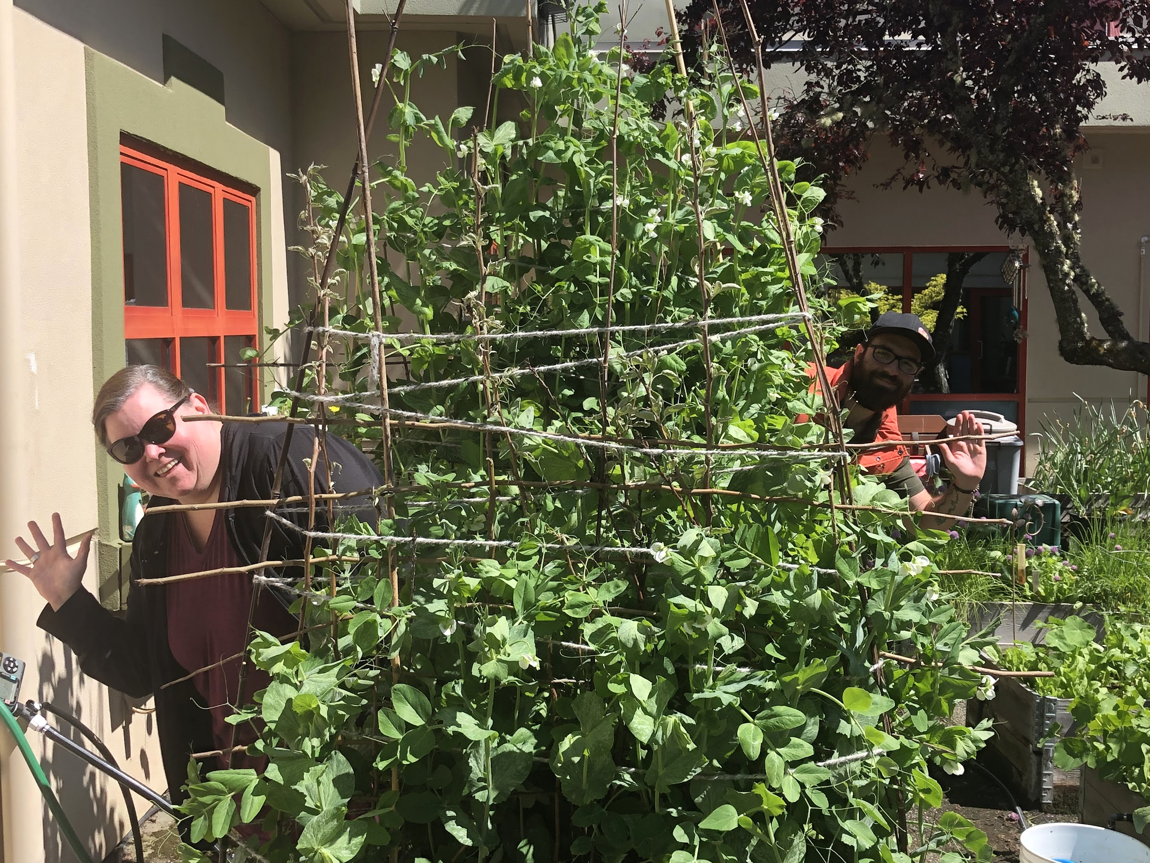
Meet your Administrators

Slide 5
Meet your Administrators
Ms. Hussey
Welcome to Kindergarten at Hans Helgesen. We are excited to get to know our new students and families as you begin the transition to joining our community. Here, you will get a peek at our lovely site and some of the activities we experience in Kindergarten. We hope the following information will help you prepare for your new adventure at school.
Mr. Carr
O SIEM! Welcome to our beautiful school. We are so lucky to be close to forests and the ocean. Sometimes we learn outside. We have a big garden in the courtyard. Our staff is very helpful. You will make new friends and have lots of fun here. I am excited to meet you soon as you begin your education journey at Hans Helgesen School! Hych’ka Siem!

Slide 6
Kindergarten at Hans Helgesen
Since we were unable to have an orientation day in person this spring, we have created this slideshow for parents and guardians to share with their children who are starting kindergarten in September to introduce you to our school.
Hans Helgesen is a rural school with nine divisions from kindergarten to grade five, and two hundred students located in Metchosin.
Kindergarten classes will each have up to twenty students. Kindergarteners will make many new friends.
We are excited to meet you!

Slide 7
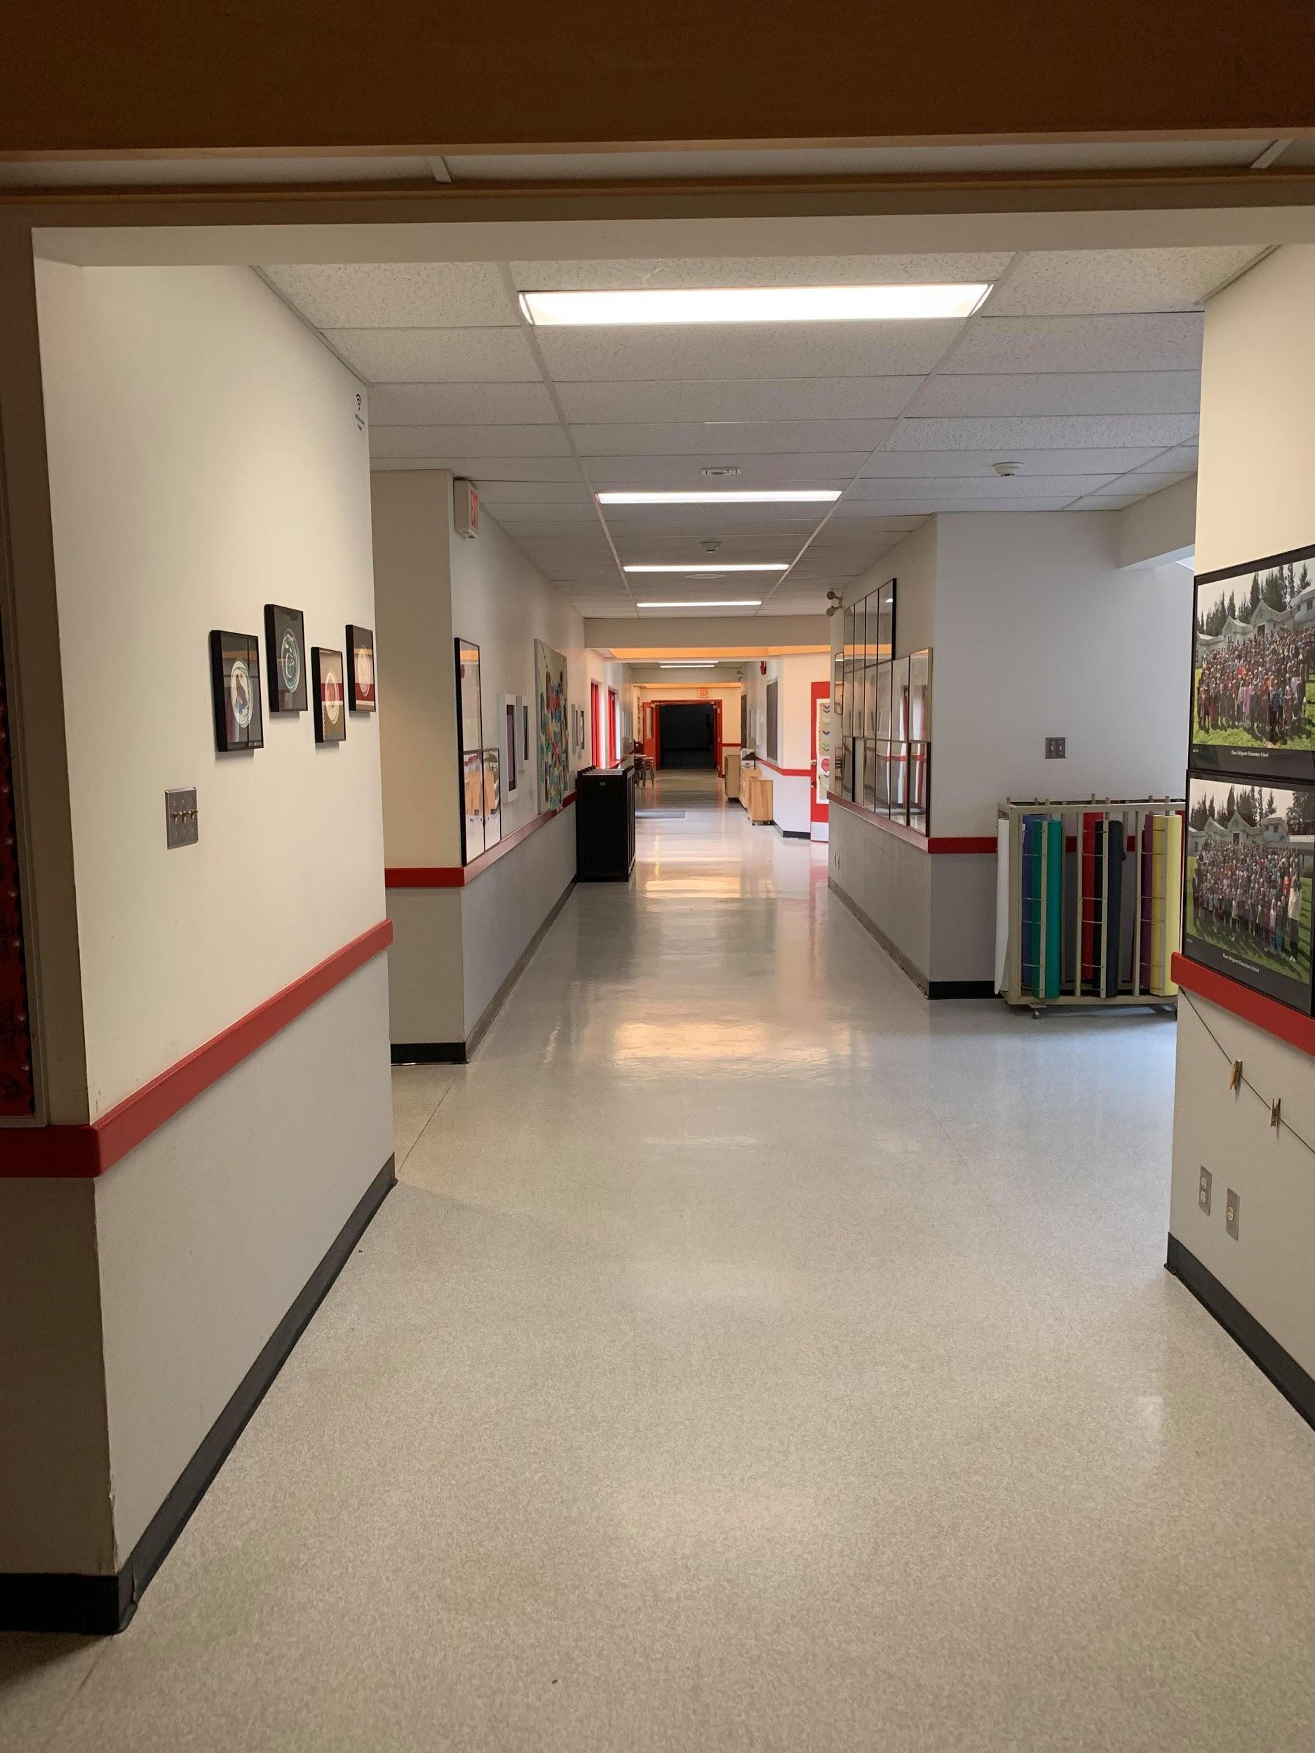
Our School
The hallways in our school look like this. Our school is shaped like a circuit and it’s easy to navigate.

Slide 8
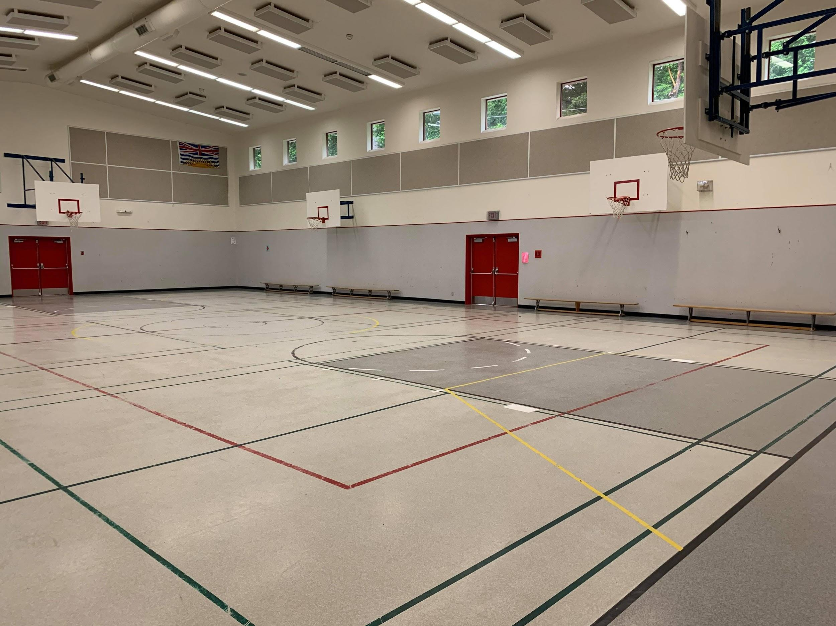
Our Gym
This is our gym where students play games and do sports together. Sometimes, we have assemblies in the gym with the whole school.

Slide 9
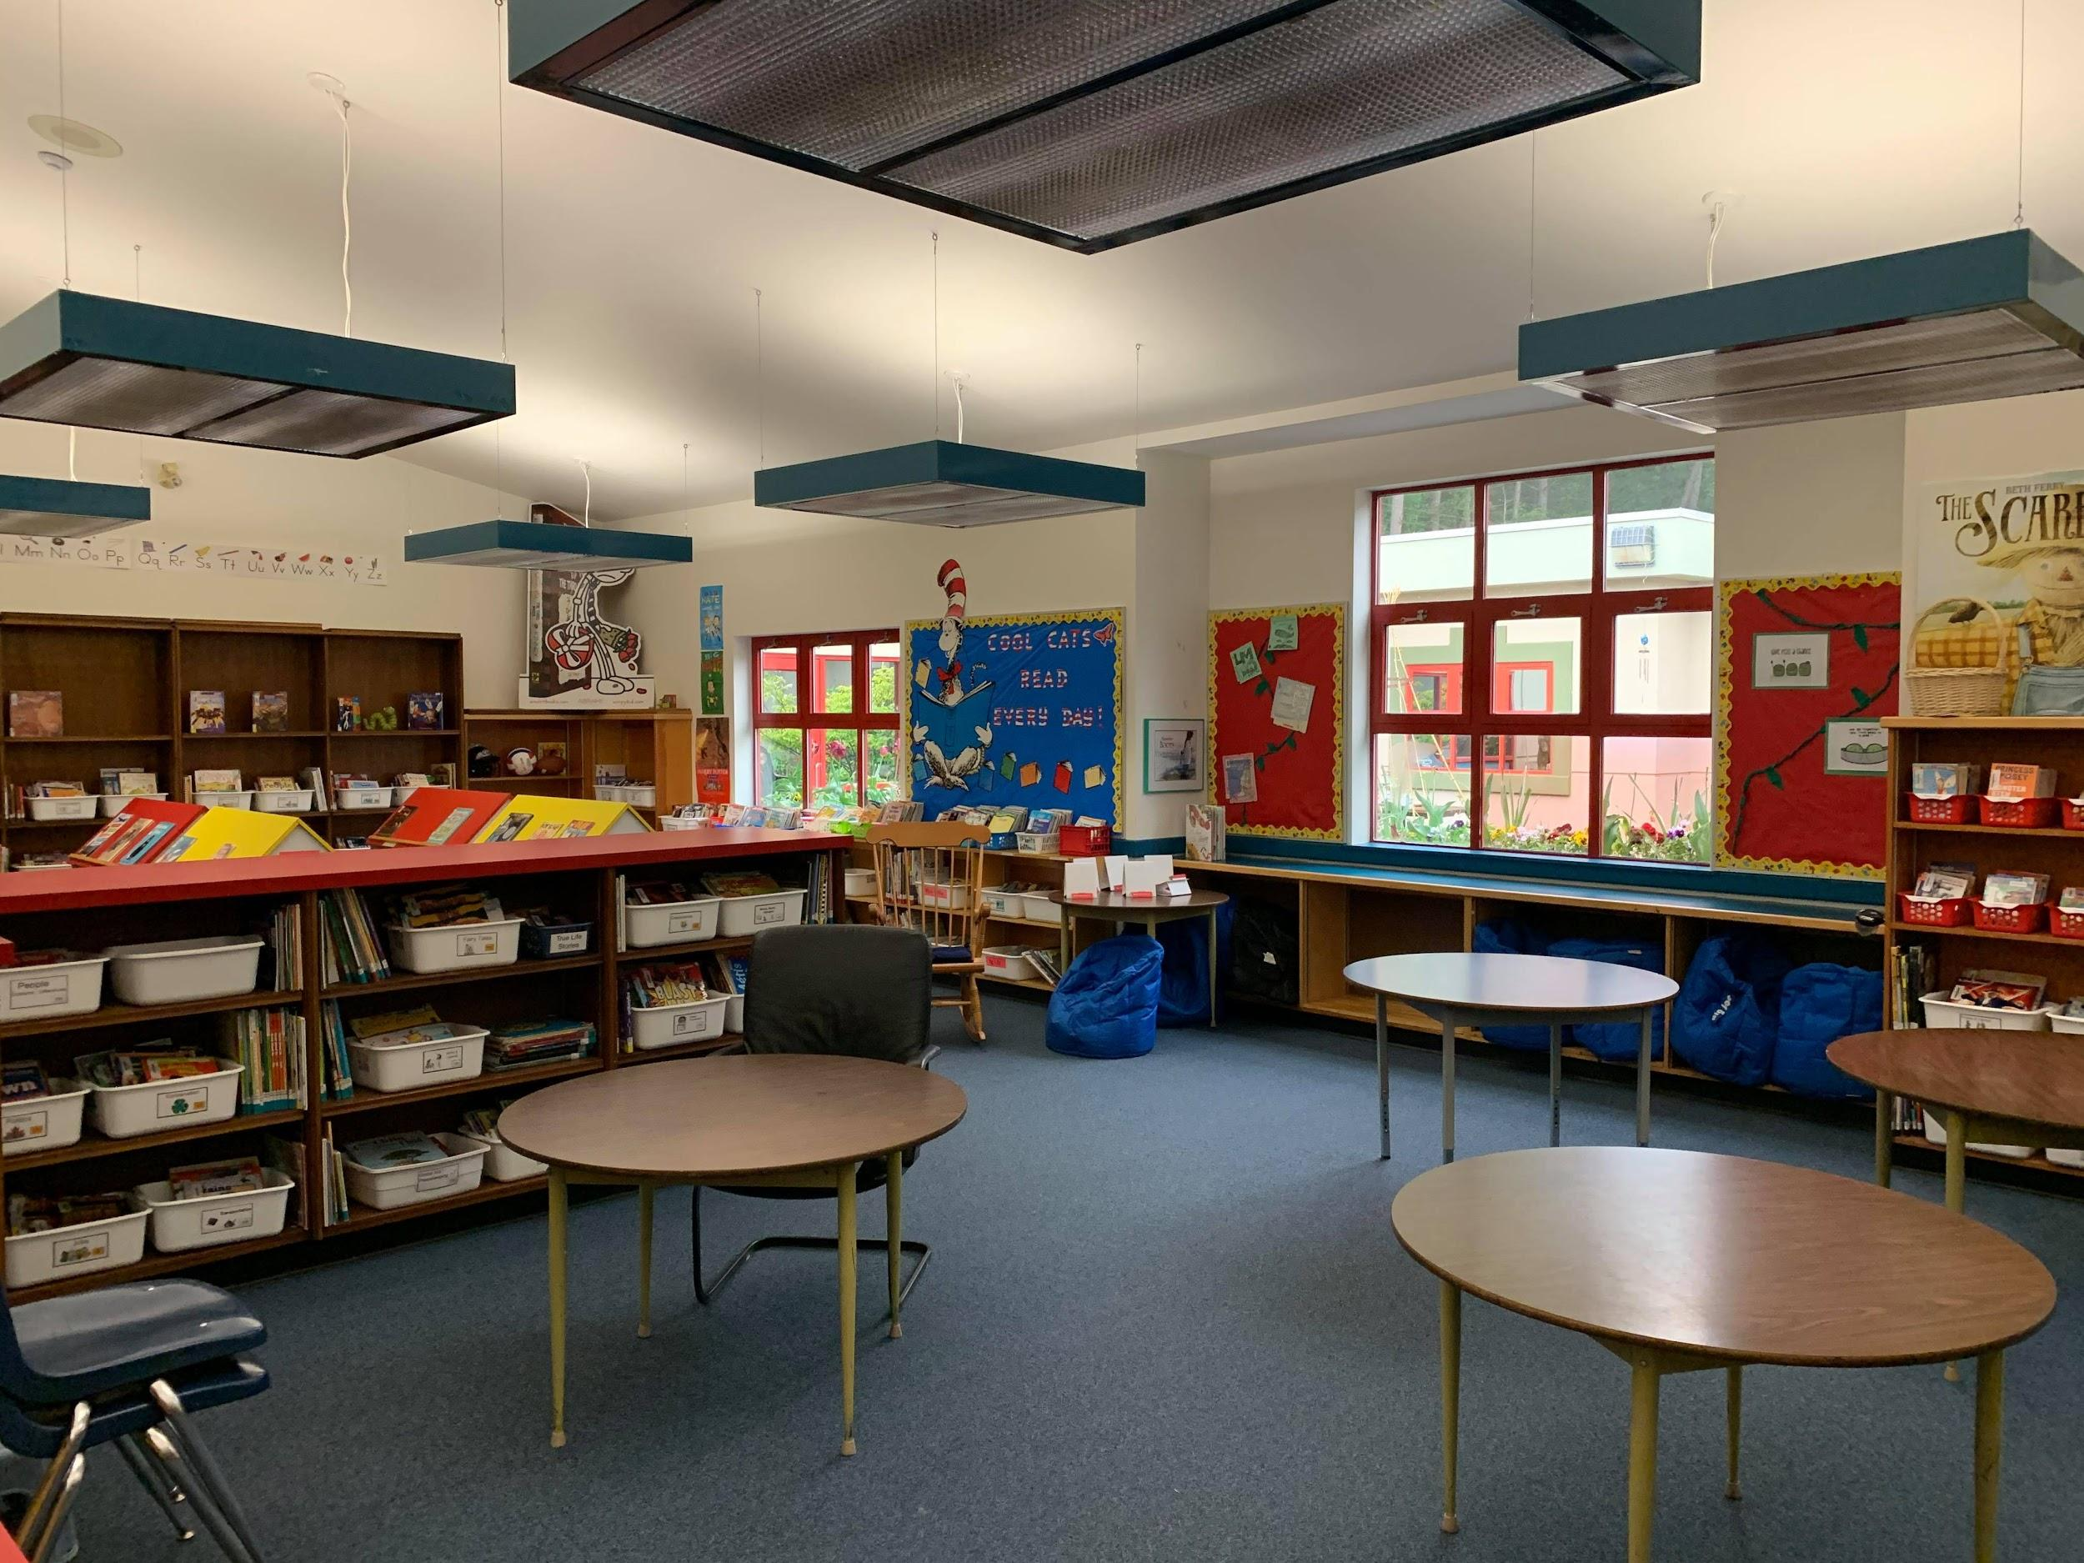
Our Library
We have a lovely open space library, home to a large assortment of books. The students visit the library every week and can borrow a book to read at home.

Slide 10
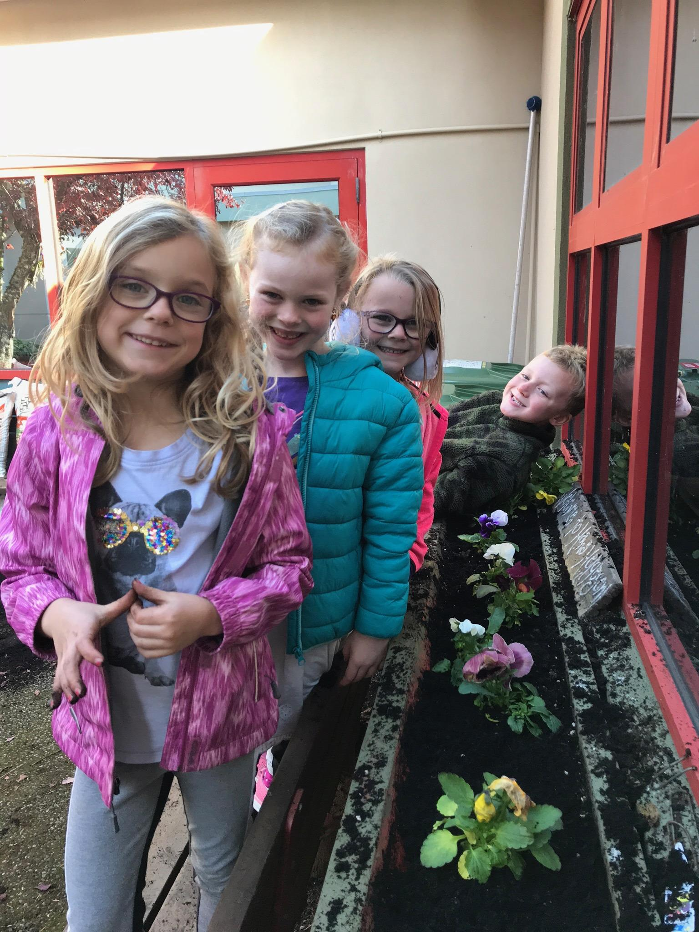
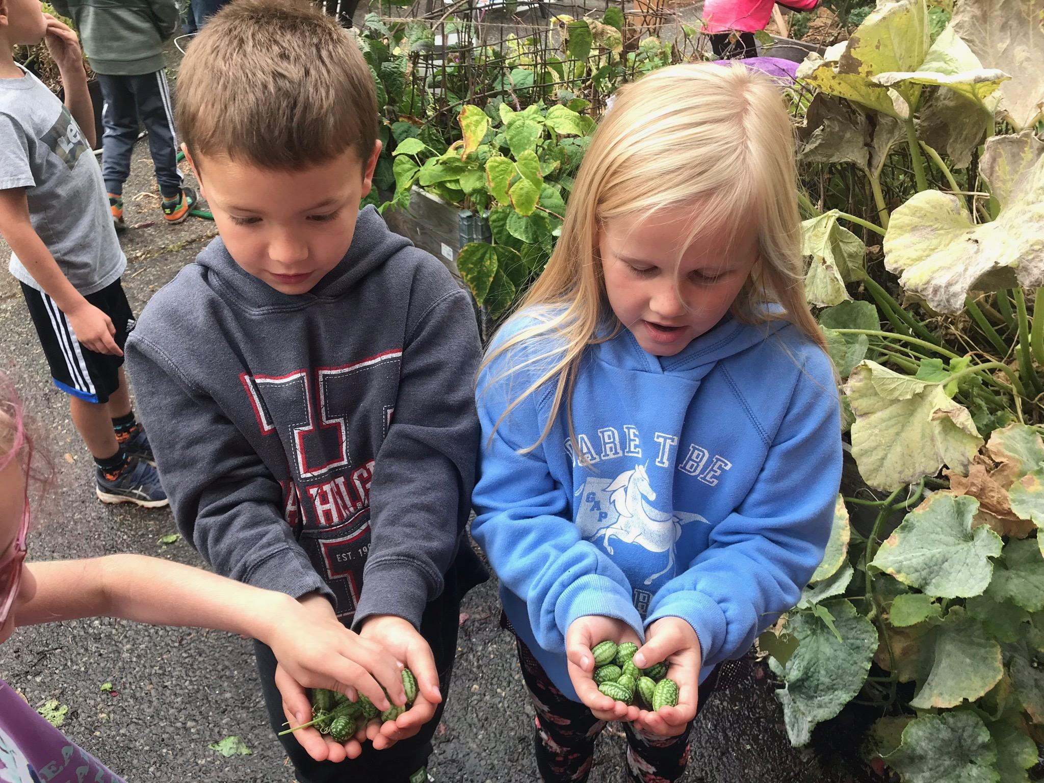
Our Courtyard
We have a courtyard at the school that is a wonderful outdoor learning space and a focal feature of our school.
This space is used for gardening, reading, art and exploration.

Slide 11
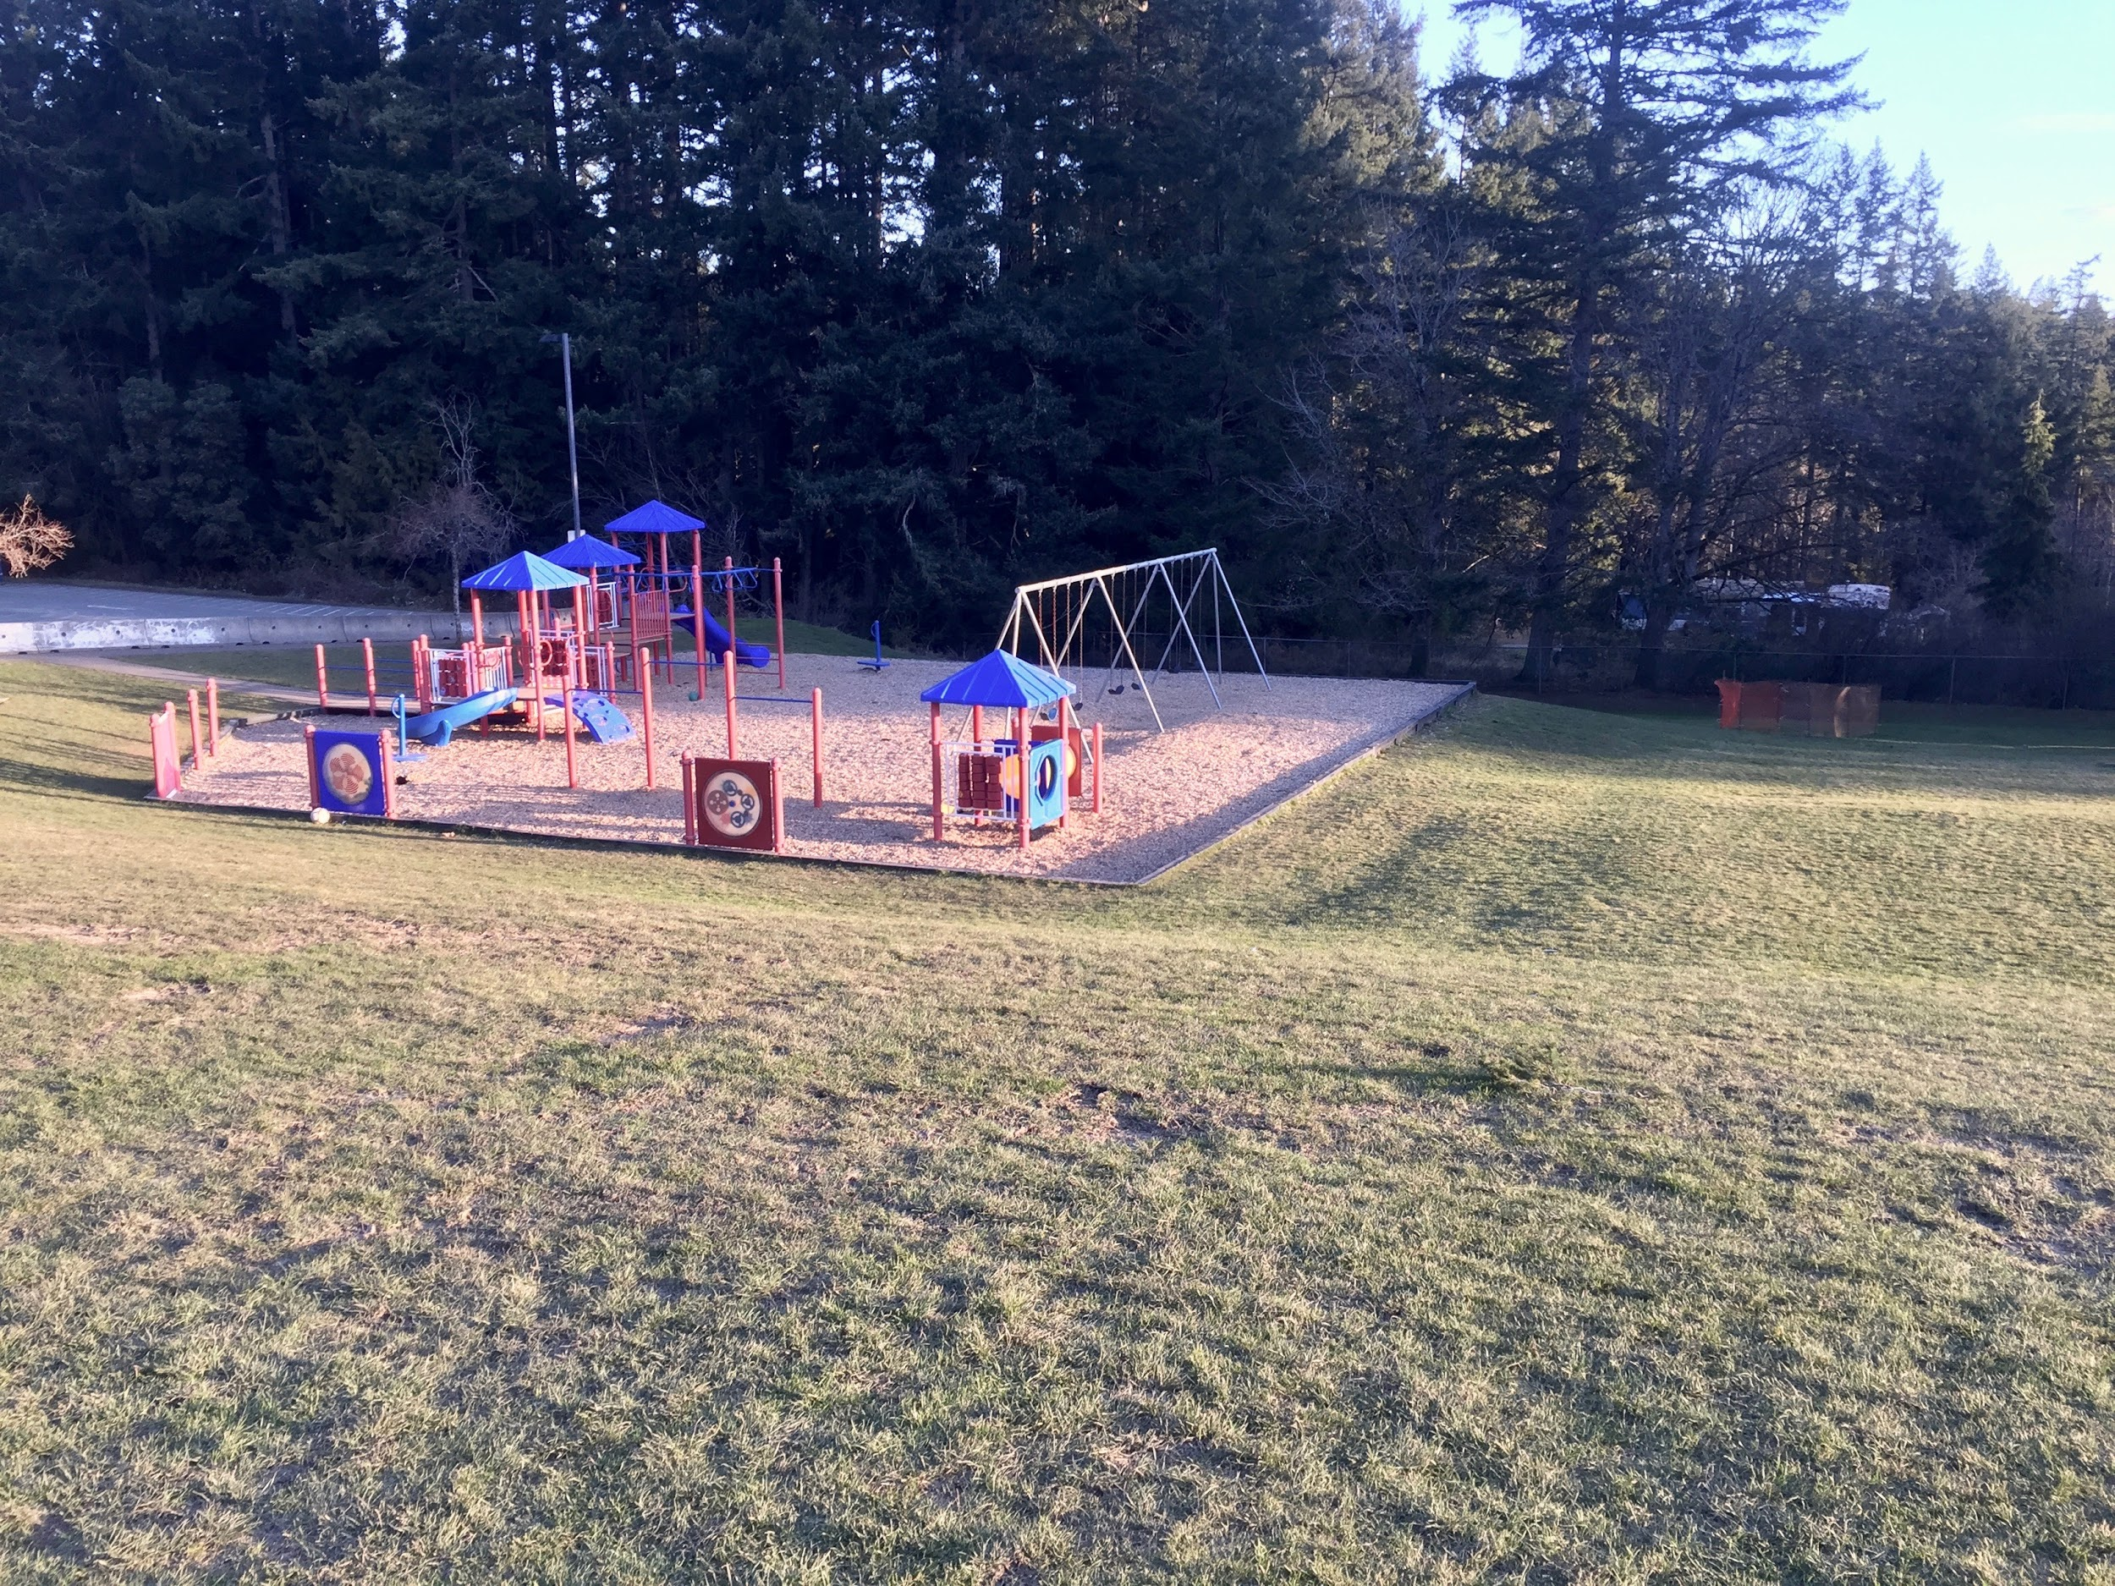
The playgrounds
We have a very large outside space including a play structure, swings, a slide, forest space and a sandpit.
This is only a little bit!!

Slide 12
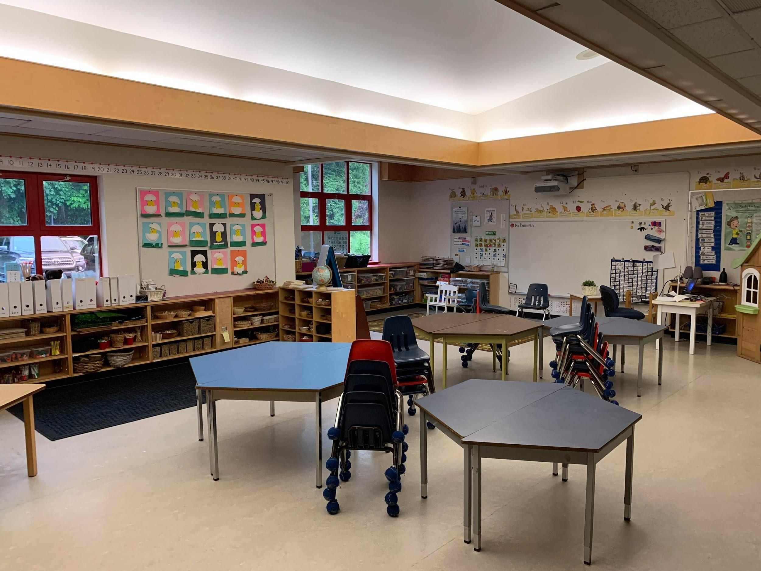
A Kindergarten Classroom
This is a typical
Kindergarten classroom.

Slide 13
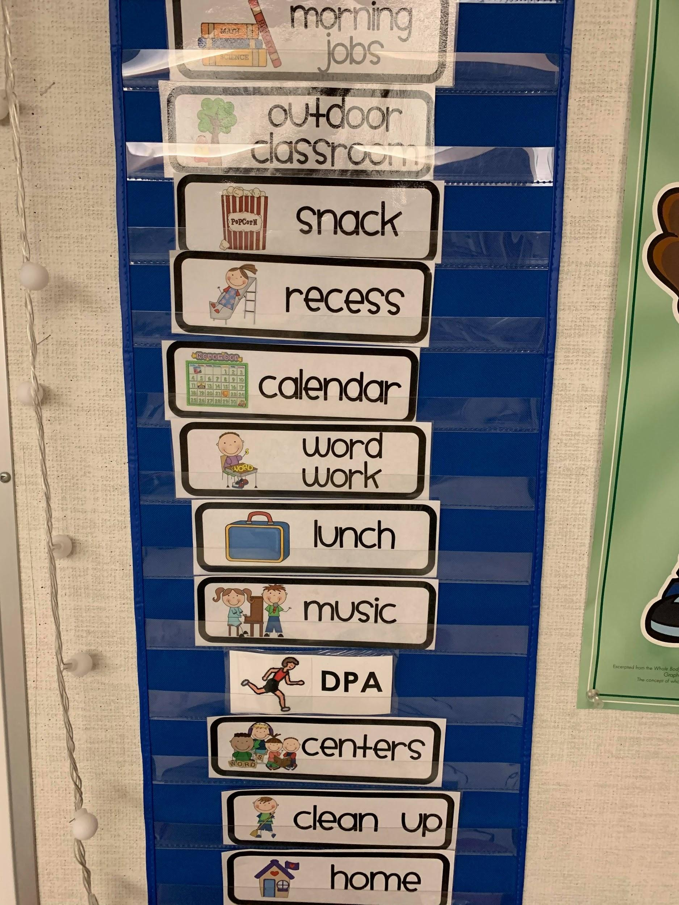
A day in kindergarten
We use visual schedules to help our students know what activities and lessons are coming up in the day. A typical school day starts in the classroom, there is a morning snack at about 10:00, then outside recess, more activities, lunch at about 11:30, a longer outside recess, quiet time after lunch and then more activities. The first bell to start the day rings at 8:20. Students are dismissed at 2:38. Students have music lessons twice a week, physical education classes twice a week, and library once a week.

Slide 14
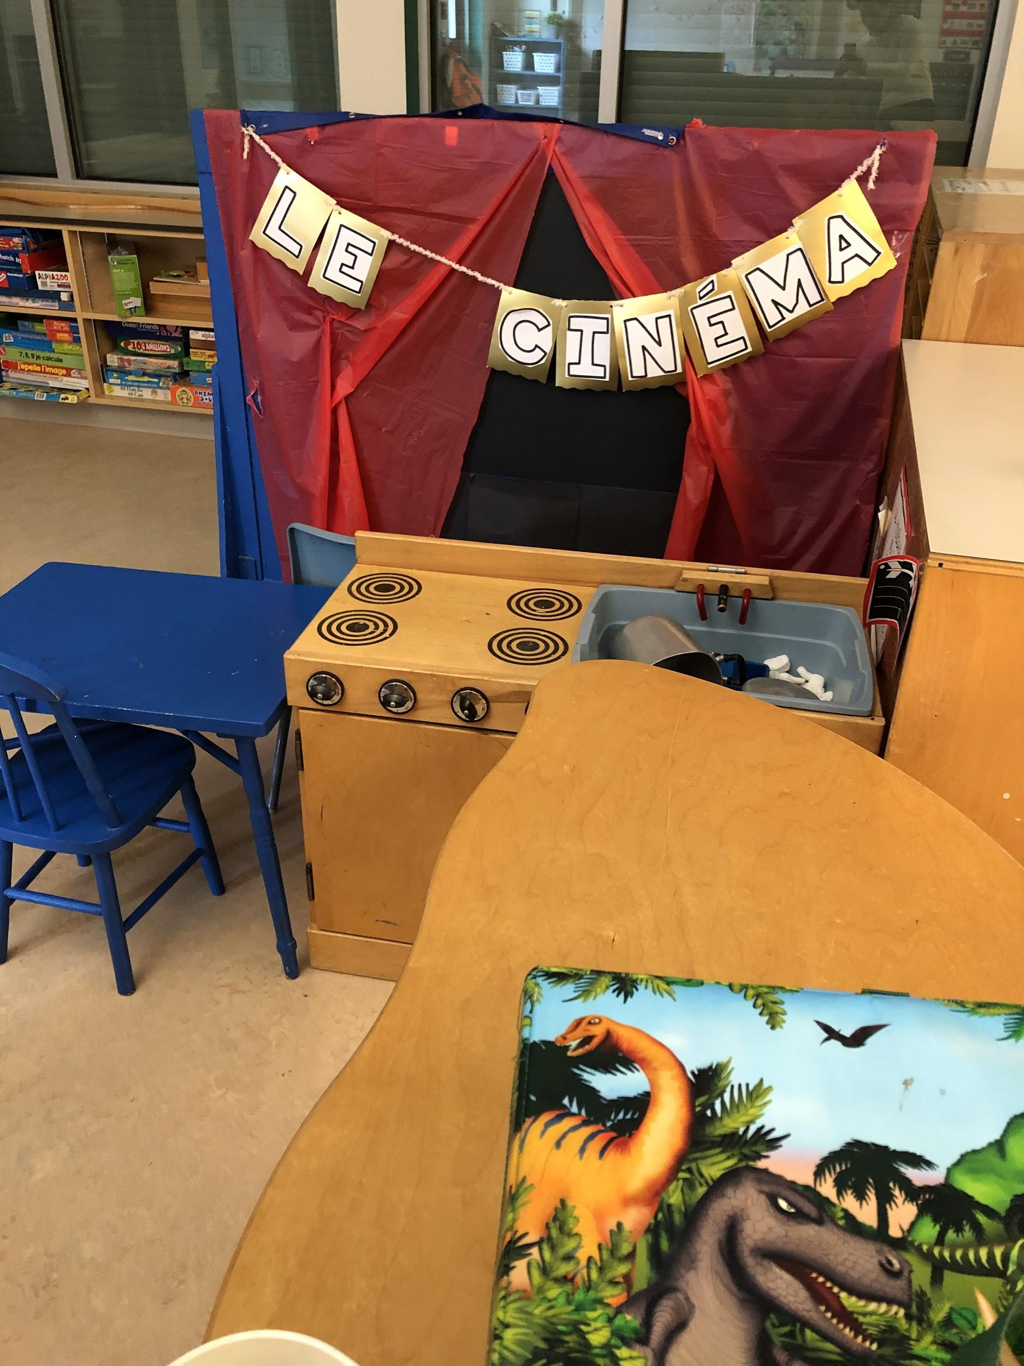
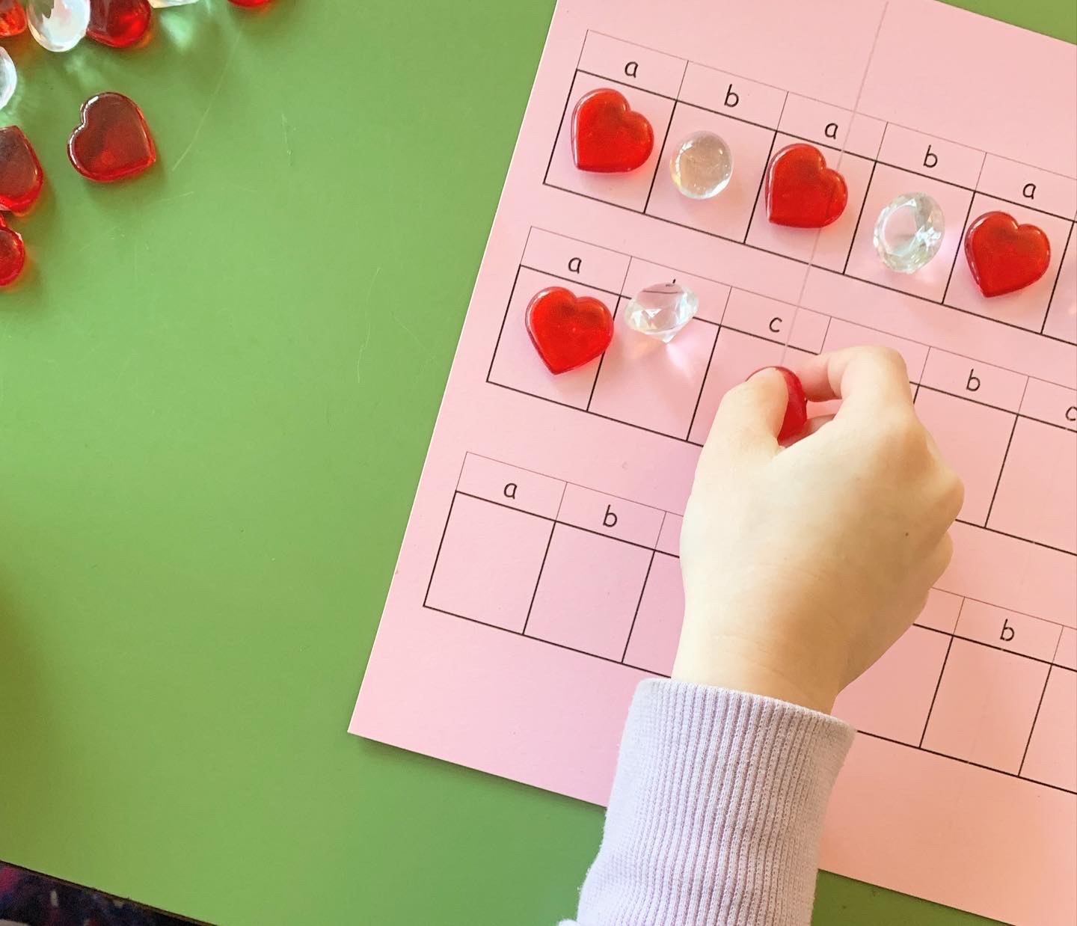
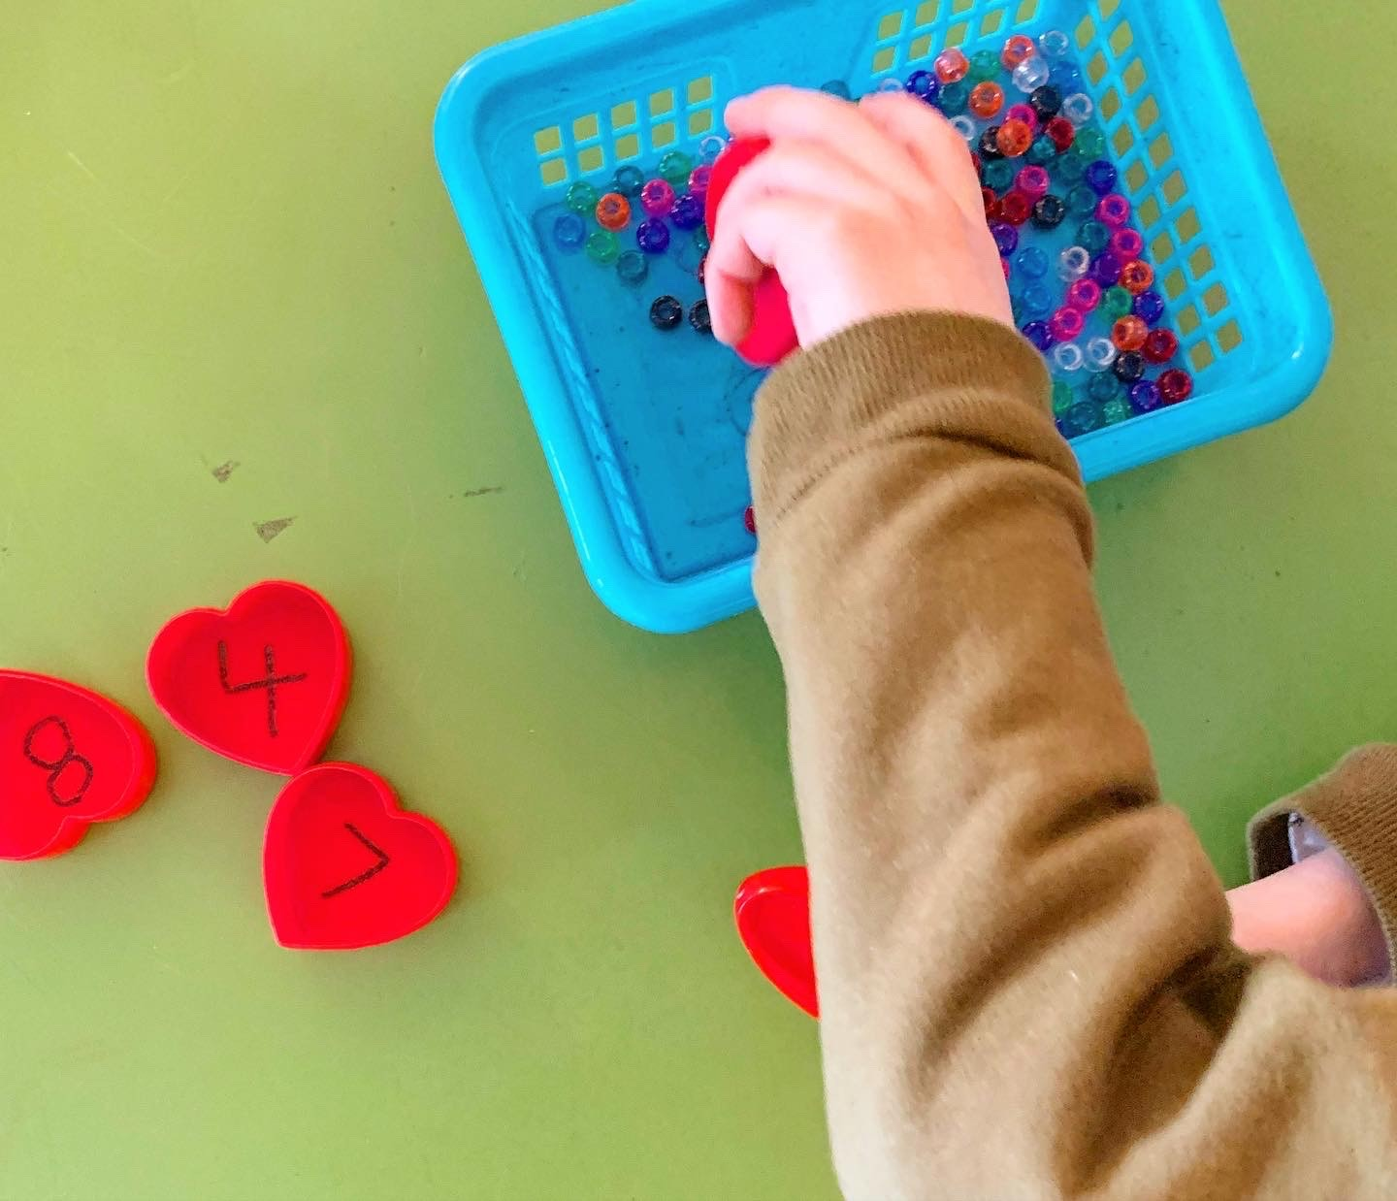
Learning is Fun. Learning is Playful!
Here are some examples of the hands on learning that occurs in a kindergarten class. The BC Ministry of Education prescribes the kindergarten curriculum under the Early Learning and Play Today Frameworks.

Slide 15
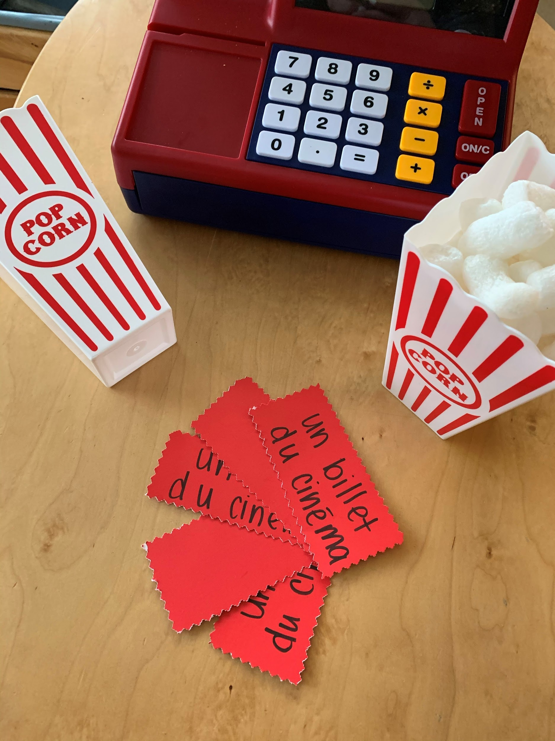
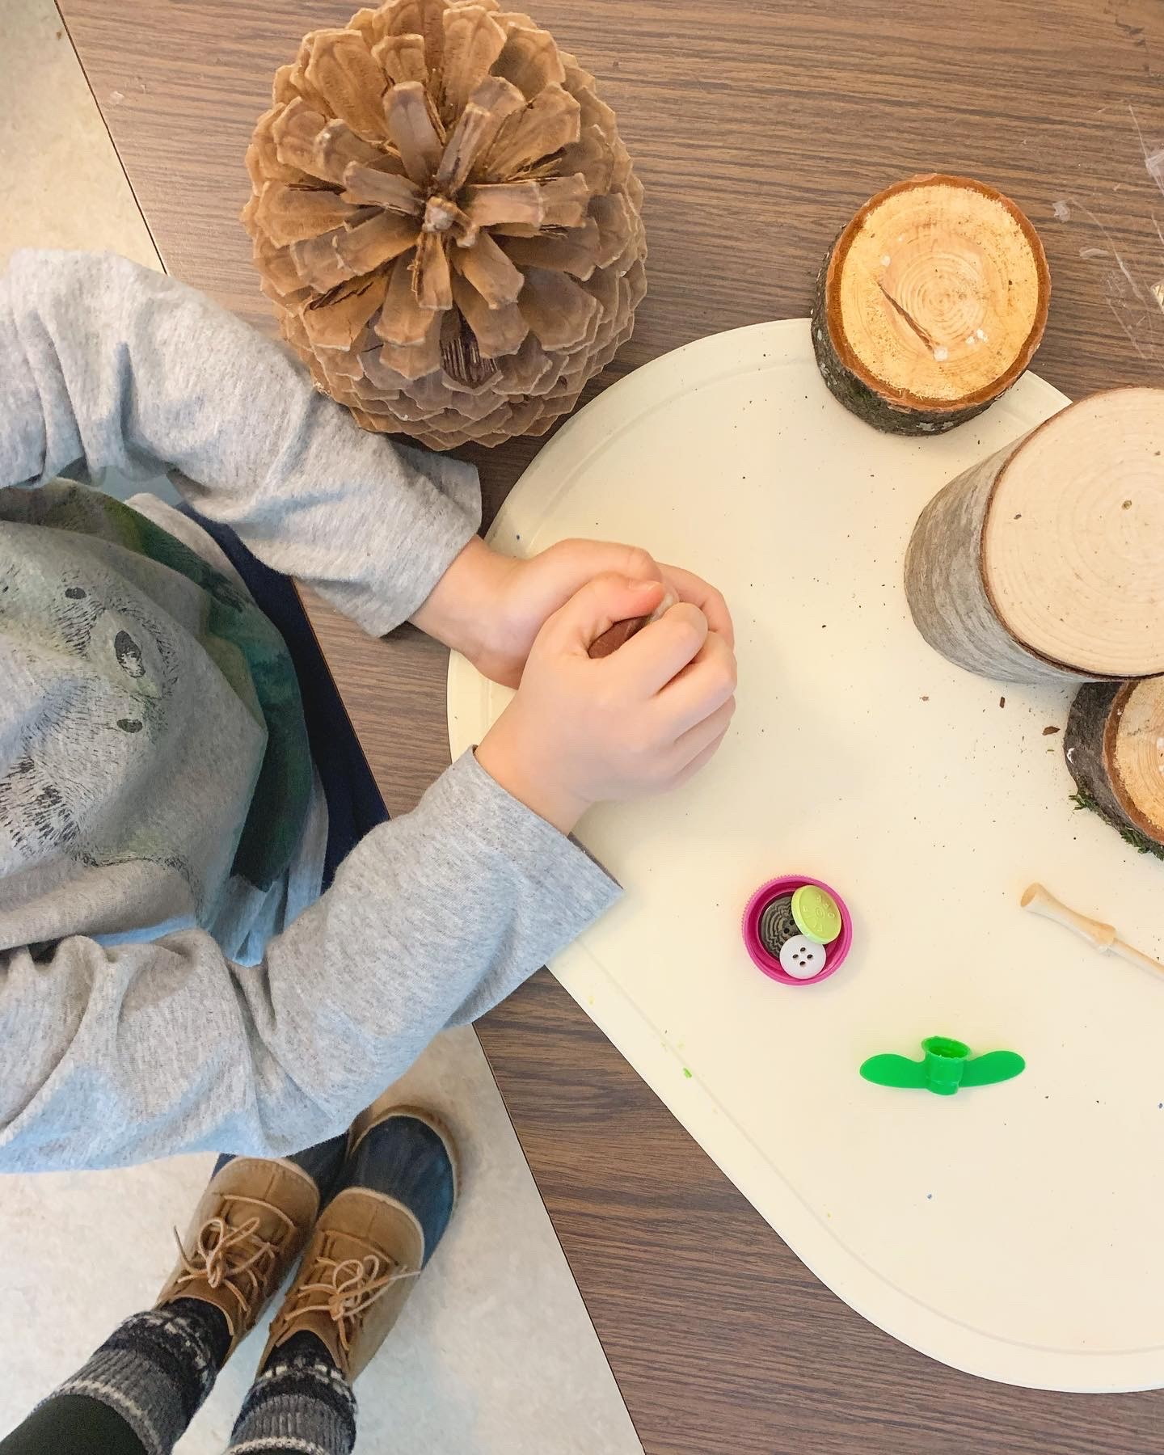
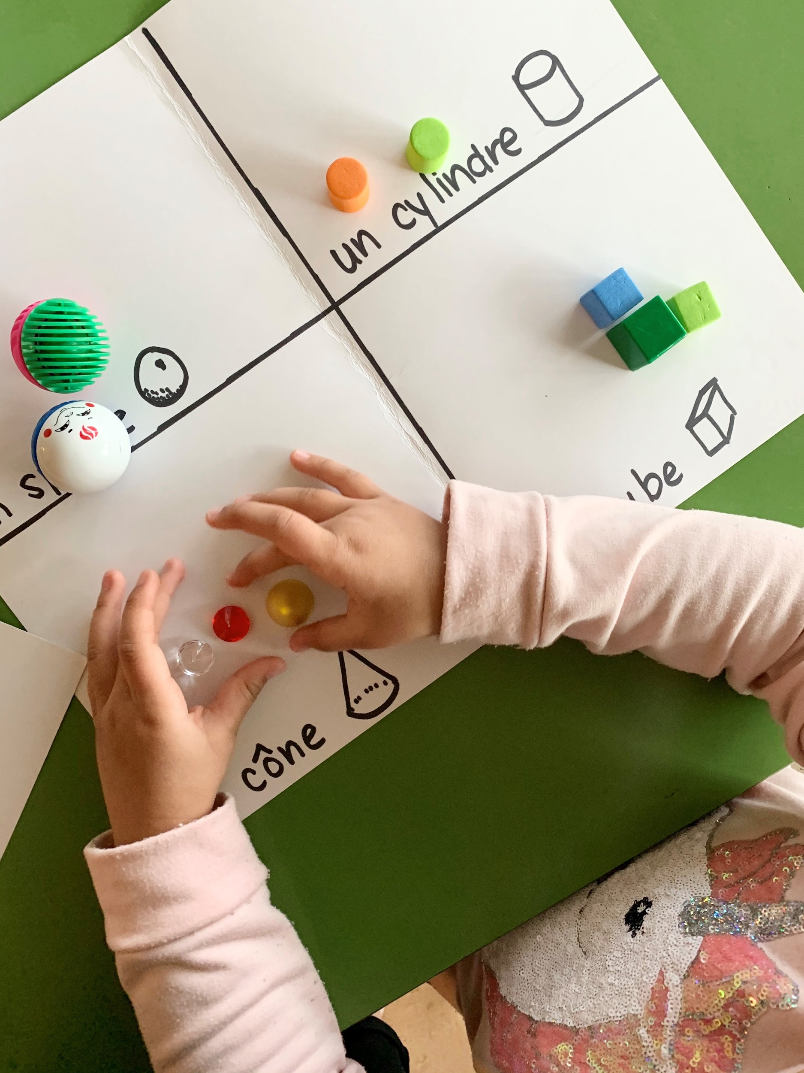
More Playful Learning
Kindergarten curriculum is play-based learning - free play, inquiry play, collaborative play, playful learning, learning games and inclusive learning practices.

Slide 16
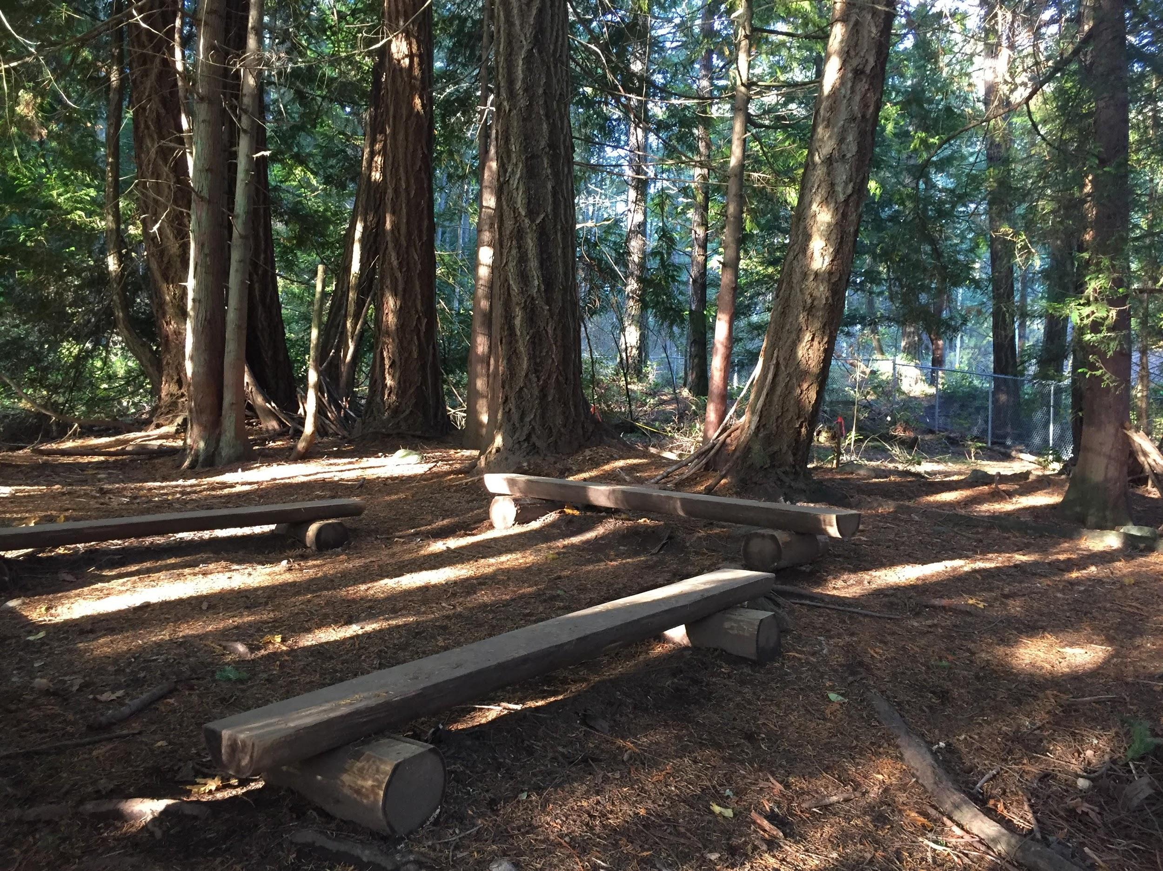
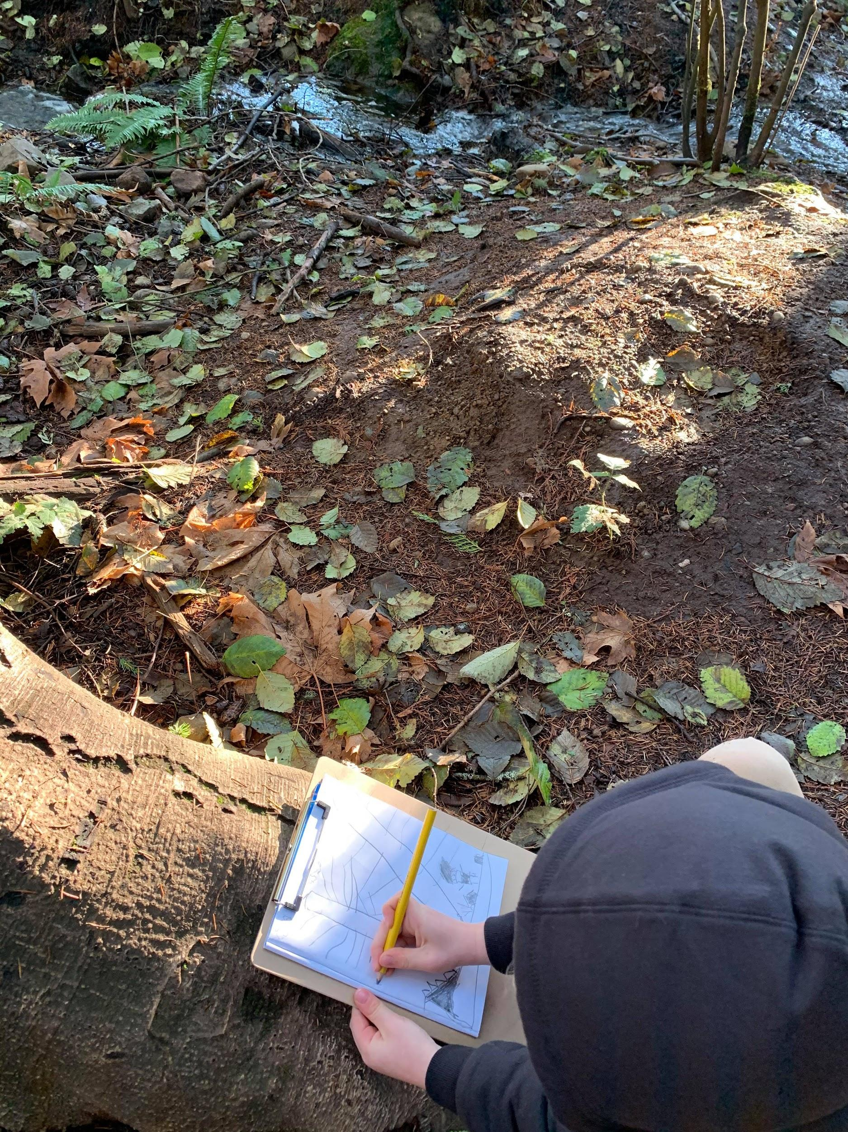
OUTDOOR LEARNING
We are fortunate to have a wonderful forest space at our school. Kindergarten students will spend some time learning outdoors. It would be advisable to keep extra rain boots or rain gear at school.
It is important your child comes to school each day prepared for the weather.

Slide 17
Preparing for kindergarten
One way to help prepare your child for kindergarten is to allow them to be independent. Independence looks different for every child. If you have any concerns about your child being independent in the school please reach out to the school so we can ensure they get the support that they need.
Be patient with your child. Learning takes time! Yes, it would be quicker to put their shoes on for them, but starting today, encourage your child to try to do this for themself. We like to use the phrase “You’ve got this!”

Slide 18
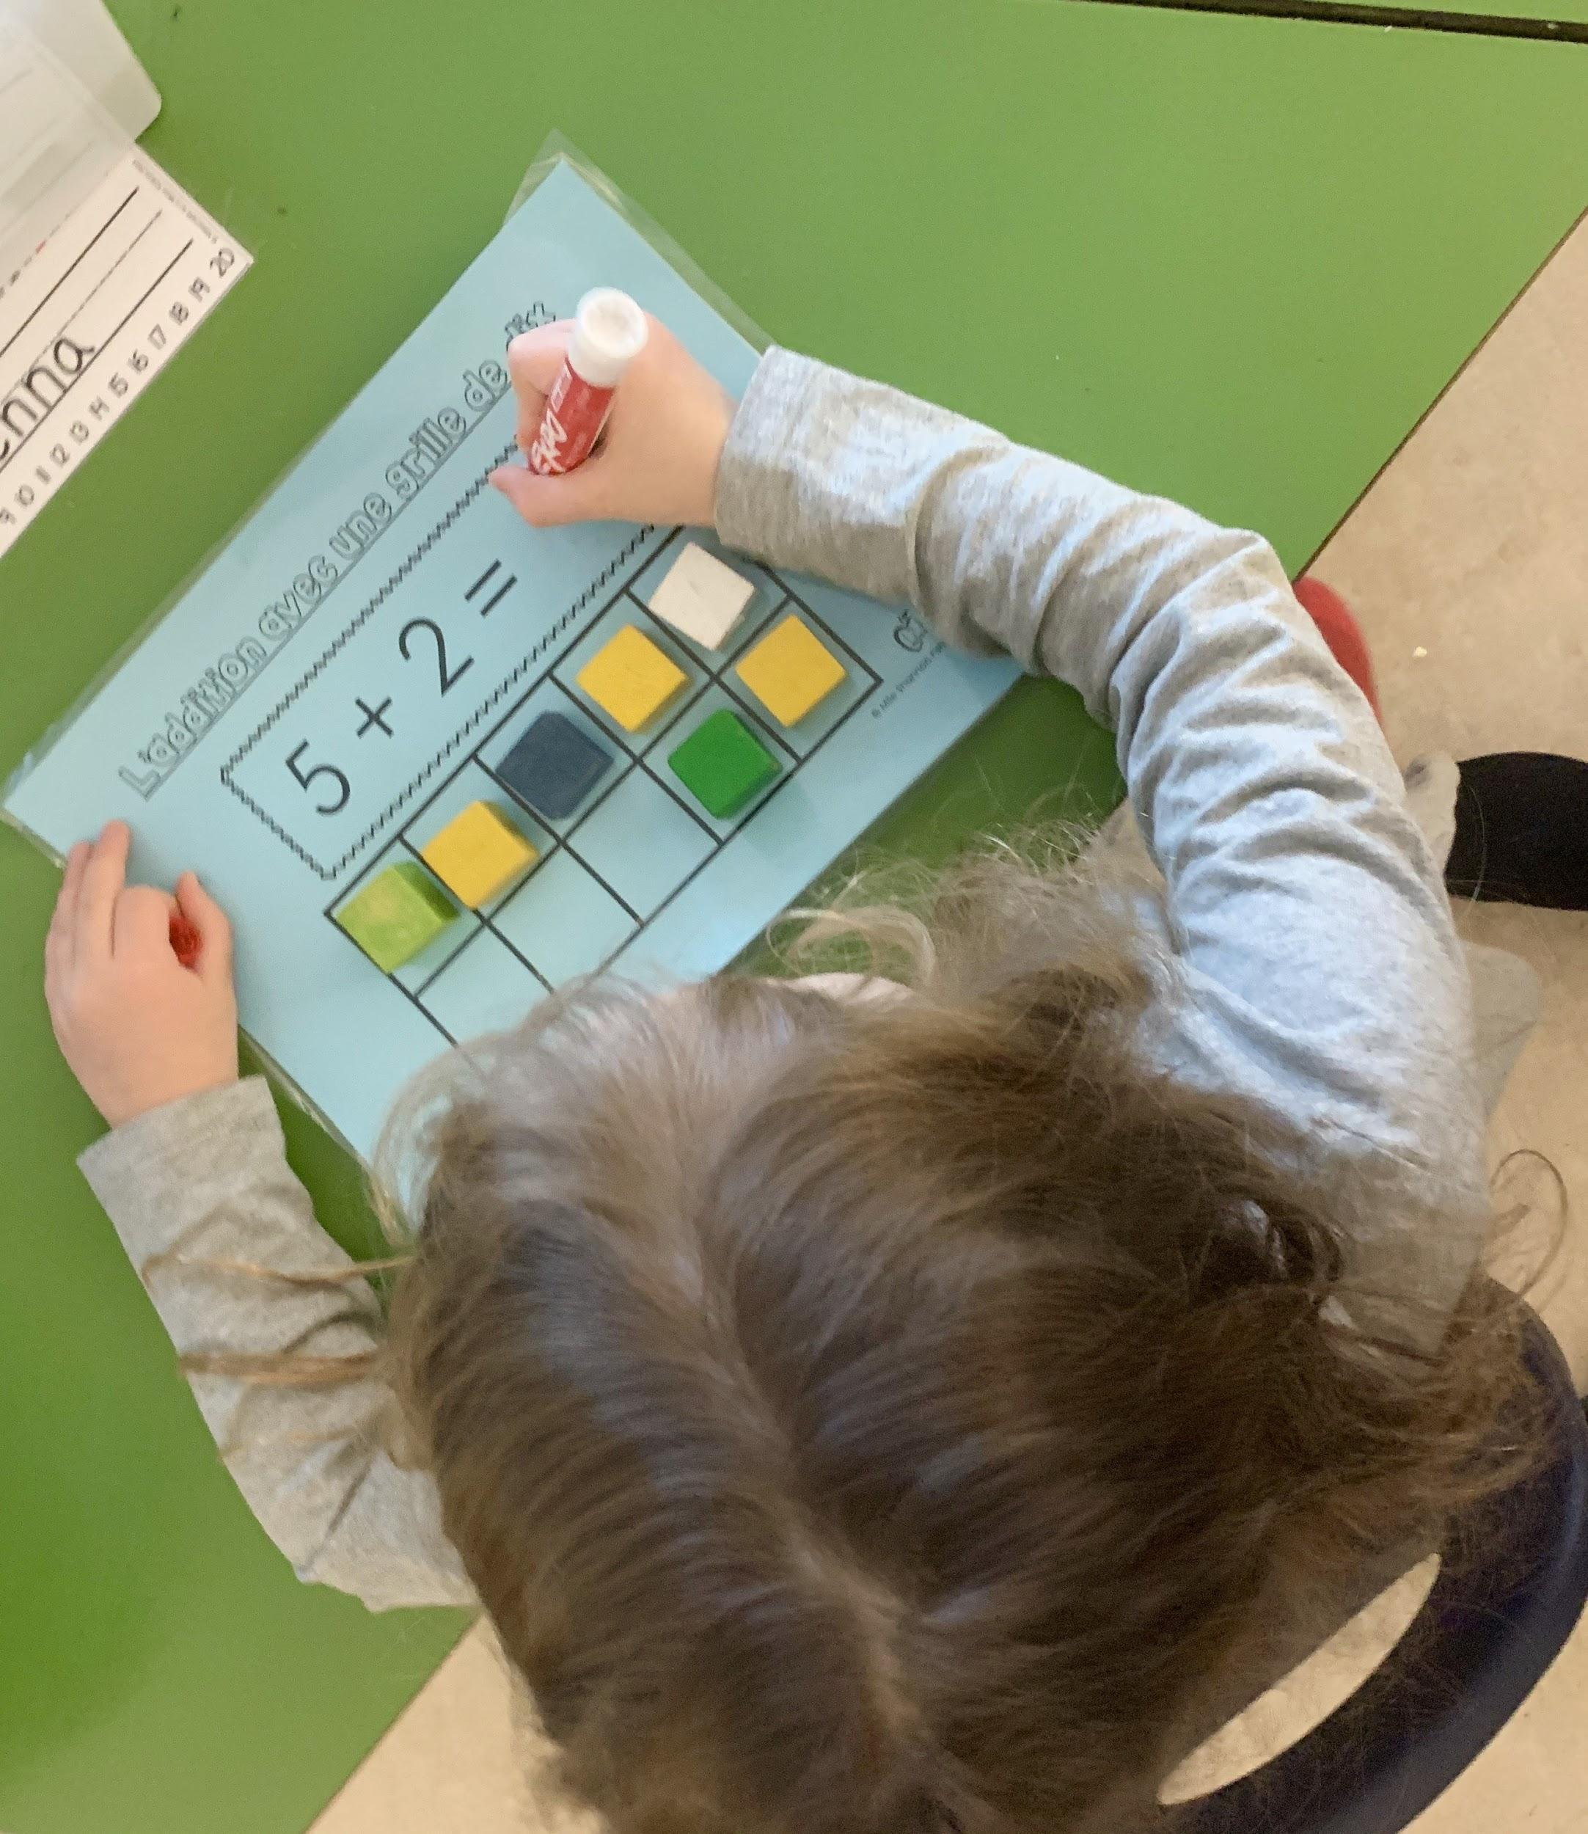
Talking to your child about kindergarten
It is important to prepare your child for kindergarten. You will want to have conversations with your child about leaving them for the school day at our safe building. Reassure your child that our school is a safe place to be and that everyone is welcome. Let them know that they will go to school each weekday, and that you will pick them up at the end of the school day.

Slide 19
Before starting Kindergarten, have your child practice these skills:
Putting on shoes, jackets, using zippers, buttons and velcro
Lunch kit - opening and closing containers, putting their lunch kit into their backpack. You could practice this by going on a fun picnic or using their lunch kit at home.
Scissors and glue - this is great fine motor practice
The bathroom - close the door, use the toilet, flush, wash hands
Identify their own shoes, jackets, backpack. Often when children start school they have a lot of new items and they don’t recognize their own belongings! Please label your child’s shoes, jackets, hoodies, backpack, water bottle and lunch kit.

Slide 20
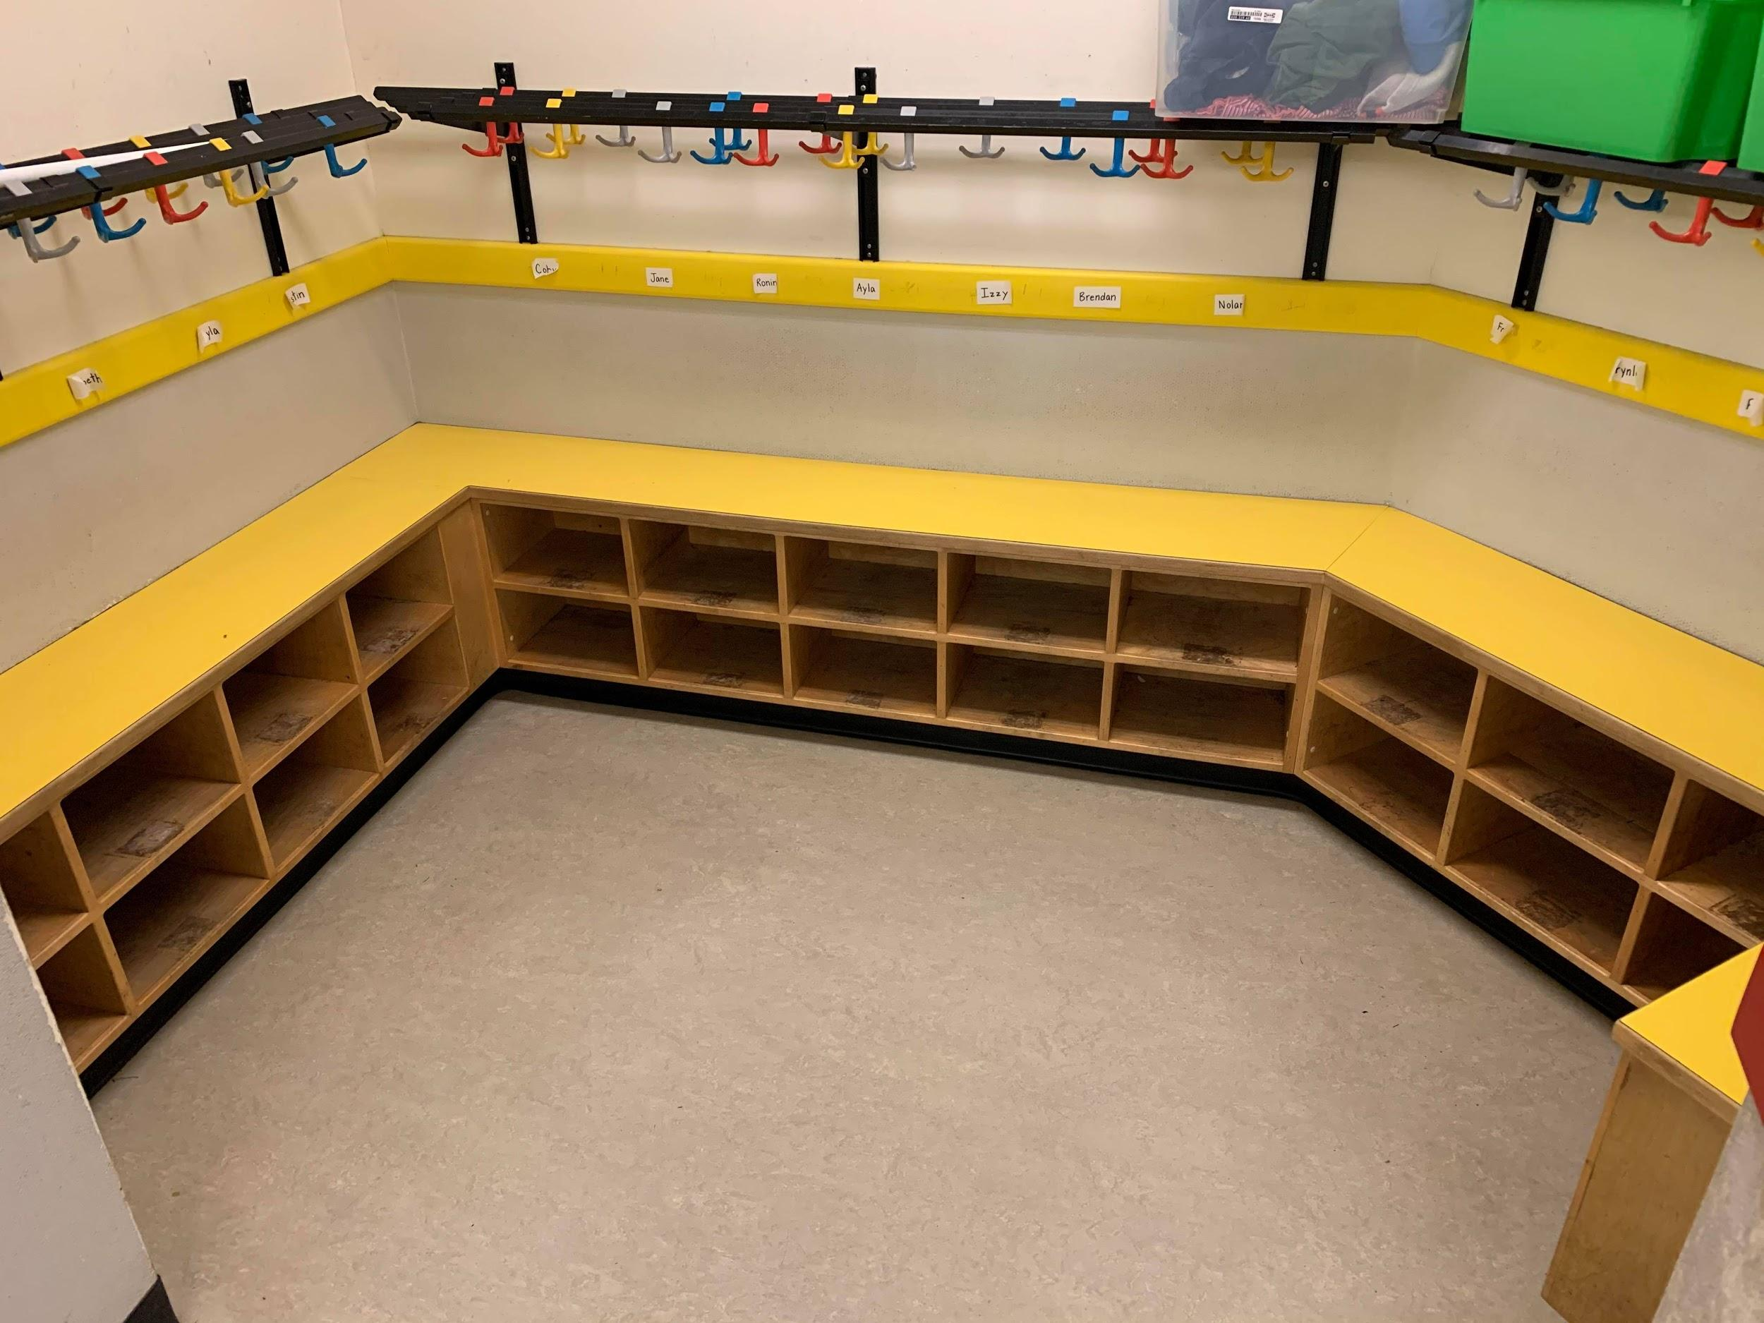
personal belongings
Each of the Kindergarten classes at Hans Helgesen has a space where students can hang up their things and keep their shoes. It is important that each child knows how to hang up their own jacket and backpack.
We ask that all students come with a pair of velcro or slip on inside shoes to keep at school, they will be changing their shoes at least 3 times a day.

Slide 21
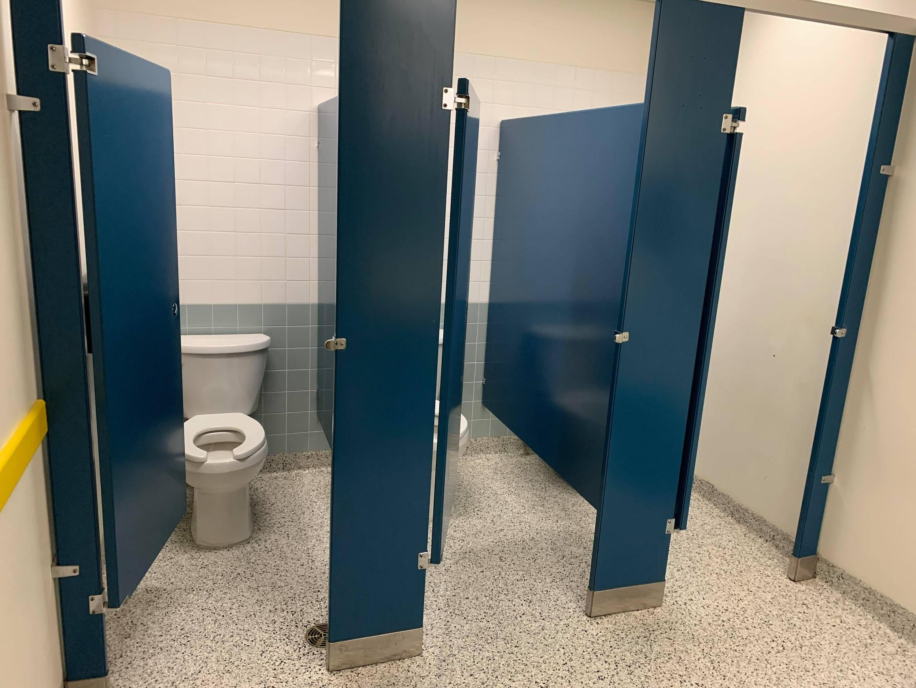
School Bathrooms
Please ensure your child can use the bathroom by themselves well before school starts. This includes wiping, flushing and washing hands. Children should know to go in, choose a stall, close the door, use the toilet, wash their hands and then go back to join their class.

Slide 22
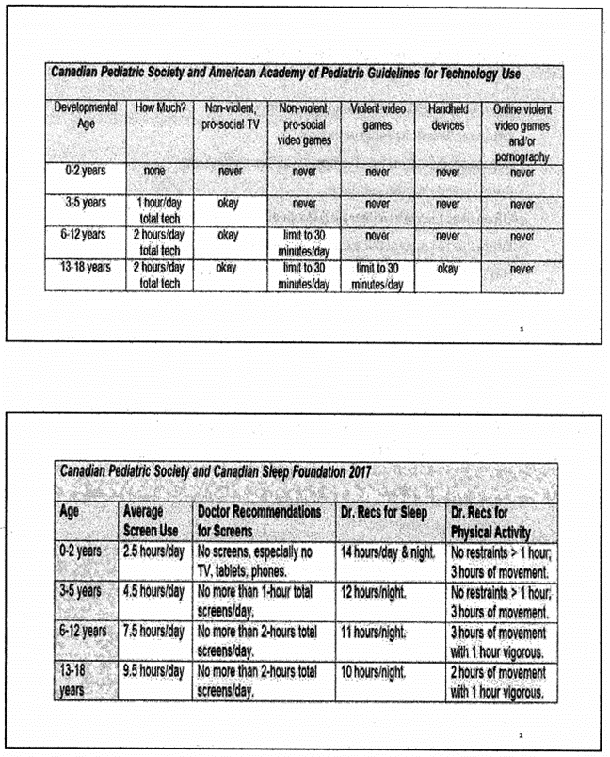
Preparing for kindergarten
Please consider the following information when you are developing habits to promote healthy sleeping, eating, physical activity and screen time habits.

Slide 23
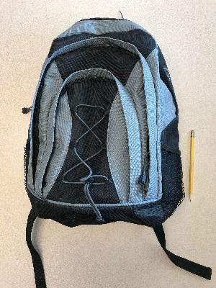
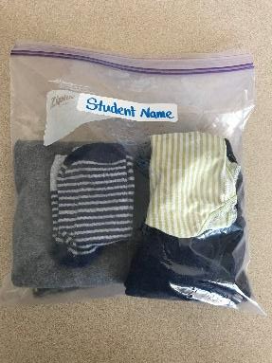
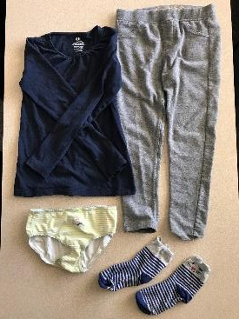
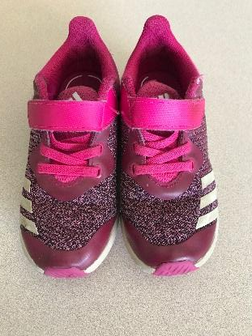
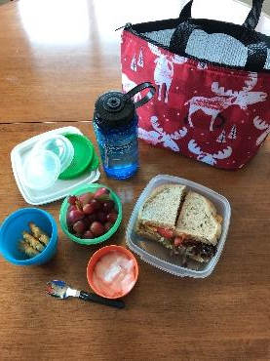
WHAT YOUR CHILD WILL NEED AT SCHOOL
*Information on school supplies will come later
Backpack:
It only needs to carry a few things (lunch kit, reading books, occasional notice) and has to fit in a narrow cubby.
Change of clothes:
Pants, shirt, socks, underwear in a labelled Ziploc bag. This will stay at school for those little accidents.
Snack and Lunch:
Looking for healthy options for your child to eat? Sandwiches, wraps, vegetables, fruit, yogurt, cheese and crackers are a few ideas. Send all necessary ice packs and cutlery, as well as, a labelled water bottle. Also keep in mind, the school will not heat up your child’s food.
Inside Shoes:
Your child needs a pair of runners to have as inside shoes. These will stay at school. Please make sure these are velcro. Slippers are not acceptable.

Slide 24
Morning Routine When Arriving At School
All elementary students wait outside in a class line-up for their teacher to greet them. When the teacher comes to lead the students to the classroom, the Kindergarten children look to their families for a happy goodbye. Students then walk to class and hang up there coats and change shoes. They are very proud of being able to complete this routine with less and less support.

Slide 25
End of Day Dismissal
Your child’s teacher will let you know where dismissal is for their class. Children are dismissed one by one as their parent, caregiver, or older sibling arrives. Your child must wait in line for their turn to get dismissed to make sure that their teacher sees that they have been picked up. Please wait until your child is at the front of the line to call them over.
Your child’s kindergarten teacher will ask you to provide a list of people who are allowed to pick up your child at the end of the day. It is also important to let your child’s teacher know if they will be taking the bus home. Please be on time to prevent worried children.

Slide 26
Medical and Health
Your child’s health and safety is very important to us. If your child has a medical condition or allergy please make sure the office is aware and has information on file.
If your child is ever required to take medication during school hours, a form must be completed and signed by your child’s doctor. Contact the school office for more information on this process before the end of June.

Slide 27
Keeping in Contact & Legal Matters
Our website is http://hanshelgesen.web.sd62.bc.ca/
Our school phone number is 250-478-3431.
To report your child’s absence please email hanshelgesen2@sd62.bc.ca
Please make sure to always have your contact information up to date, including your home address, your email and emergency contact information.
*If there are legal matters pertaining to your child’s custody, please ensure you provide a copy to the school office in advance of school start.*

Slide 28
Gradual Entry
Children will start kindergarten in September with a gradual entry, where they are invited to come in for shorter amounts of time over a few days then build up to a full kindergarten day.
We will keep you posted on this year’s Kindergarten gradual entry.

Slide 29
Questions?
Please contact our administration team with your questions:
250-478-3431
Principal Cathy Hussey
Vice-Principal Jon Carr
We are looking forward to meeting you and your child this Fall.

